Slide 1

CHAT BOT USING MACHINE LEARNING
PIP104 PROFESSIONAL PRACTICE-II
VIVA-VOCE
Roll Number | Student Name
20201COD0029 | Y.SIVASAI REDDY
20201COD0051 | S.ANNAMAIAH
Under the Supervision of,
Mr. PAJANY M
Assistant Professor
School of Computer Science Engineering
Presidency University
Batch Number:

Slide 2
Introduction
People these days watch movies for far too much entertainment, and because of their busy schedules and time constraints, they are willing to finish all tasks quickly. However, finding different movies on different websites takes time and is a laborious process. We have developed an effective Bot that engages with users in a courteous manner in order to solve the aforementioned issue. Natural Language Processing (NLP) components AIML and LSA were used to construct this movie application bot. Applications utilizing artificial intelligence are created using AIML, a markup language based on XML.
Processing the user's query and comparing it to the pre-existing questions in the database is done via latent semantic analysis, which speeds up the process of finding the right answer. chatbot, which escapable of providing thoughtful responses to user inquiries.
The Internet is full of resources that we can use to host our customized Numerous businesses, institutions, and organizations use these services to provide for their customers. Artificial Intelligence Markup Language, or AIML, is one of the most popular languages for creating bots.

Slide 3
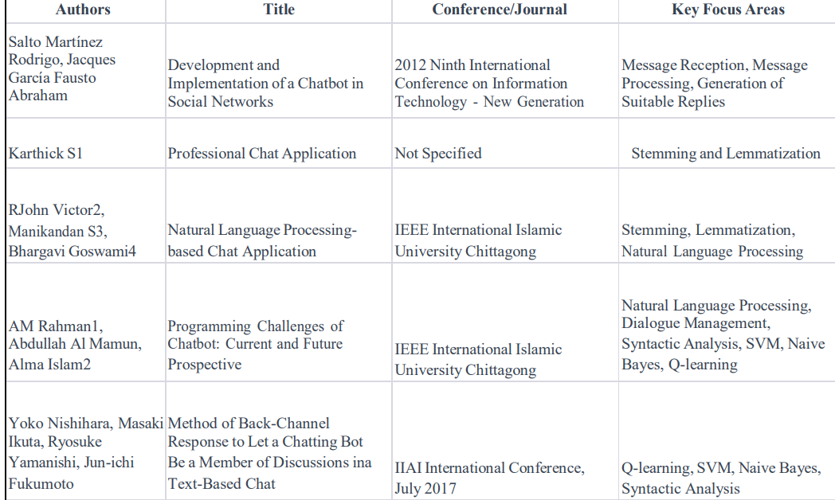
Literature Review

Slide 4
Research Gaps Identified
Despite significant progress, there are still areas in need of study and improvement in the field of machine learning-based chatbot.
Limited Variability within the Sets:
1.Research Gap: Many of the datasets currently used for the training of the chatbot lack diversity in terms of demographics, lifestyle, and geographic representation.
2.Existing methods: Researchers have used popular datasets. To increase the generalizability of the model, more diverse datasets from different populations enhance models.
Choosing Features and Their Significance:
1.Research Gap: It's still difficult to determine which features are most important. Comprehending the attributes that substantially contribute to precise forecasting is crucial for both clinical applicability and model interpretability.

Slide 5
Research Gaps Identified
2.Current Approaches: Recursive Feature Elimination (RFE), feature importance derived from treebased models, and domain knowledge- driven feature selection are a few of the feature selection strategies that have been used. But more reliable and automated are required.

Slide 6
Proposed Methodology
Modeling real-world objects and systems, makes use of use case diagrams. Planned requirements, hardware design validation, software product testing and debugging, online help reference creation, and customer service-oriented tasks are examples of system objectives. In a product sales setting, for instance, use cases can include client relations, payment processing, ordering items, and catalog updating.
Problem Definition and Data Collection:
Give specifics about the goals, intended audience, and project boundaries for chatbot development. Determine the sources of pertinent data: Gather a variety of datasets with data on lifestyle, factors.

Slide 7
Proposed Methodology
Data Preprocessing:
Managing missing data involves either removing or imputed values from the dataset. guarantee consistency Code variables that are categorical: Utilize methods such encoding to translate categorical variables into representations
Exploratory Data Analysis (EDA):
To comprehend feature distribution, spot correlations, and learn more about possible relationships between variables, do exploratory data analysis (EDA). To identify patterns and trends in data, visualize it with charts.

Slide 8
Objectives
Based on the research gaps identified in the literature survey, here are four focused objectives for further investigation:
1.Real-Time Responsiveness Enhancement:
❖Rationale: Address the observed delays in traditional ticketing systems and FAQ sections.
❖Objective: Develop and implement strategies to enhance real-time responsiveness in customer support systems, ensuring swift resolution of user queries and issues.
2.Advanced Natural Language Processing (NLP) Integration:
❖Rationale: Acknowledge challenges in user articulation and precision in queries.

Slide 9
Objectives
❖Objective: Explore and implement advanced NLP techniques to improve the system's understanding of user intent, making it more proficient in interpreting and responding to diverse queries
3.Optimization of Human-AI Collaboration:
❖Rationale: Recognize the effectiveness of human-operated live chat in complex query resolution.
❖Objective: Investigate methods to optimize the collaboration between human operators and AI systems, aiming for seamless integration that maximizes efficiency and user satisfaction.

Slide 10
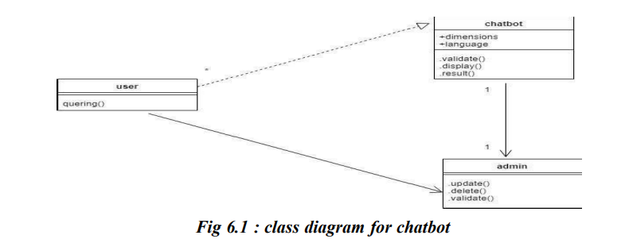
System Design & Implementation
Class Diagram : A static diagram is the class diagram. It depicts an application's static view. The class diagram is used not only to build the executable code of a software application but also to visualize, describe, and record various features of a system.

Slide 11
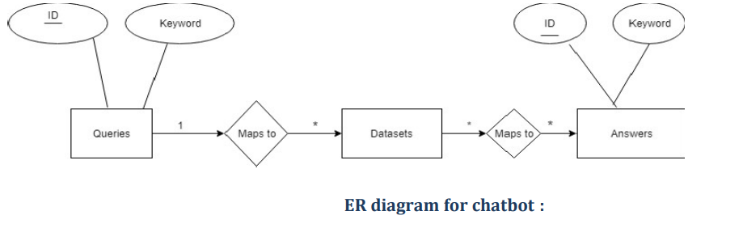
System Design & Implementation
Create message: In the sequence diagram, a new object is instantiated using a Create message. There are times when creating an object is necessary for a certain message call.

Slide 12
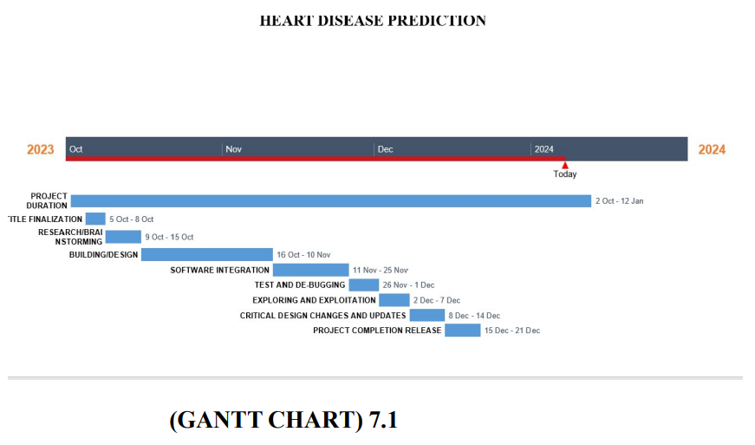
Timeline of Project
GANTT CHART :

Slide 13
Outcomes / Results Obtained
1.Real-Time Responsiveness Enhancement:
❖Outcome:Implementation of real-time responsiveness strategies results in a substantial reduction in query resolution times, ensuring timely and efficient support for users.
2 Advanced Natural Language Processing (NLP) Integration:
❖Outcome: Successful integration of advanced NLP techniques leads to a significant improvement in the system's ability to accurately comprehend and respond to diverse user queries, enhancing overall user satisfaction.
3.Optimization of Human-AI Collaboration:
❖Outcome:Investigation and implementation of collaboration optimization methods result in a harmonious blend of human expertise and AI capabilities,leading to more effective and user- friendly query resolution

Slide 14
Outcomes / Results Obtained
4.Continuous Learning Mechanisms Implementation:
❖Outcome Development and implementation of continuous learning mechanisms empower the customer support system to adapt dynamically to changing customer queries and expectations, ensuring long-term relevance.
5.Enhanced User Satisfaction:
❖Outcome: The cumulative impact of real-time responsiveness, improved language understanding, optimized collaboration, and continuous learning mechanisms results in heightened user satisfaction, 18 fostering a positive user experience

Slide 15
Conclusion
A chatbot is a growing trend that improves customer satisfaction at a minimal cost, thereby increasing business efficacy. Developing a basic chatbot is not as difficult as creating a complicated one, although developers still need to take high-level human language purpose into account as well as reliability, scalability, and adaptability concerns. In summary, chatbots are a rapidly evolving ecosystem, and as time goes on, new capabilities are introduced to the current platform. It offers a productive and successful means of communication. Our project provides information about movies who are searching for the details in different websites.

Slide 16
References
[1]. Naive bayes algorithm, https://www.analyticsvidhya.com/blog/2017/09/naive-bayes- explain
[2]. Ramya Ravi,” Intelligent Chatbot for Easy web analytics design”
[3]. Salomon Jacobus du Preez, Manoj Lall and Saurabh Sinha, An Intelligent Web-Based Voice Chat Bot, in EUROCON 2009, EUROCON '09. IEEE, 2009, p. 386.
[4]. Bhavika R. Ranoliya , Nidhi Raghuwanshi and Sanjay Singh,” Chatbot for University Related FAQs”
[5]. Salto Martínez Rodrigo, Jacques García Fausto Abraham, Development and Implementation of a Chat Bot in a Social Network, in Ninth International Conference on Information Technology - New Generations, 2012.
[6].Karthick S1 , R John Victor2 , Manikandan S3 , Bhargavi Goswami4,” Professional Chat Application based on Natural Language Processing”

Slide 17
Publication Details
Registration ID:IJCRT_249319.) has been Accepted for publication in the International Journal of Creative Research Thoughts ISSN: 2320-2882.Scholarly open access journals, Peer-reviewed, and Refereed Journals, Impact factor 7.97 (Calculate by google scholar and Semantic Scholar | AI-Powered Research Tool) , Multidisciplinary, Monthly, Indexing in all major database & Metadata, Citation Generator, Digital Object Identifier(DOI)
https://ijcrt.org/track.php?r_id=249319

Slide 18
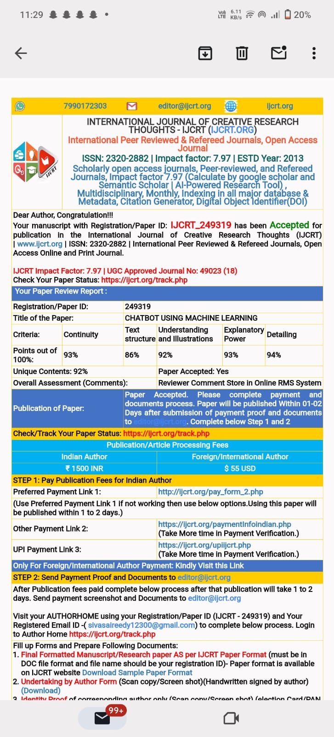
Achievements :

Slide 19

Thank You

